Slide 1
The Traveling Salesman Problem
Unit 04 : Dynamic Programming

Slide 2
Introduction
We have seen how to apply dynamic programming to a subset selection problem (0/1 knapsack).
Now we turn our attention to a permutation problem. Note that permutation problems will usually be much harder to solve than subset problems as there are n! different permutations of n objects while there are only 2^{n} different subsets of n objects (n! >2^{n}).

Slide 3

The Traveling Salesman Problem
Let G = (V,E) be a directed graph with edge costs C_{ij}.
C_{ij} is defined such that C_{ij} > 0 for all i and j and
Let IVI = n and assume n > 1.
A tour of G is a directed cycle that includes every vertex in V.
The cost of a tour is the sum of the cost of the edges on the tour.
The traveling salesperson problem is to find a tour of minimum cost.

Slide 4
TSP : Application 1
Suppose we have to route a postal van to pick up mail from mail boxes located at n different sites.
An n + 1 vertex graph may be used to represent the situation. One vertex represents the post office from which the postal van starts and to which it must return.
Edge < i, j > is assigned a cost equal to the distance from site i to site j.
The route taken by the postal van is a tour and we are interested in finding a tour of minimum length.

Slide 5
TSP : Application 2
Suppose we wish to use a robot arm to tighten the nuts on some piece of machinery on an assembly line.
The arm will start from its initial position (which is over the first nut to be tightened), successively move to each of the remaining nuts and return to the initial position.
The path of the arm is clearly a tour on a graph in which vertices represent the nuts.
A minimum cost tour will minimize the time needed for the arm to complete its task (note that only the total arm movement time is variable; the nut tightening time is independent of the tour).

Slide 6
TSP : Application 3
Consider a production environment in which several commodities are manufactured on the same set of machines.
The manufacture proceeds in cycles. In each production cycle, n different commodities are produced.
When the machines are changed from production of commodity i to commodity j, a change over cost C_{ij} is incurred.
It is desired to find a sequence in which to manufacture these commodities. This sequence should minimize the sum of change over costs (the remaining production costs are sequence independent). Since the manufacture proceeds cyclically, it is necessary to include the cost of starting the next cycle. This is just the change over cost from the last to the first commodity.
Hence, this problem may be regarded as a traveling salesperson problem on an n vertex graph with edge cost C_{ij} being the changeover cost from commodity i to commodity j.

Slide 7
TSP : Using Dynamic Programming
Let a tour to be a simple path that starts and ends at vertex 1.
Every tour consists of an edge < 1, k > for some k ∈ V - { 1} and a path from vertex k to vertex 1.
The path from vertex k to vertex 1 goes through each vertex in V - { 1, k} exactly once.
It is easy to see that if the tour is optimal then the path from k to 1 must be a shortest k to 1 path going through all vertices in V - { 1, k }.
Hence, the principle of optimality holds.
Let g(i,S) be the length of a shortest path starting at vertex i, going through all vertices in S and terminating at vertex 1.
Then g ( 1, V - { 1 } ) is the length of an optimal salesperson tour.

Slide 8

TSP : Using Dynamic Programming
From the principal of optimality it follows that:
Generalizing (1) we get
(1)
(2)

Slide 9


TSP : Using Dynamic Programming
(1) may be solved for g(1, V - {1}) if we know g(k, V - { 1, k }) for all choices of k.
The g values may be obtained by using (2).
Clearly,
Hence, we may use (2) to obtain g(i,S) for all S of size 1.
Then we can obtain g(i, S) for S with |S| = 2 etc.
When |S|< n - 1, the values of i and S for which g (i, S) is needed are such that

Slide 10
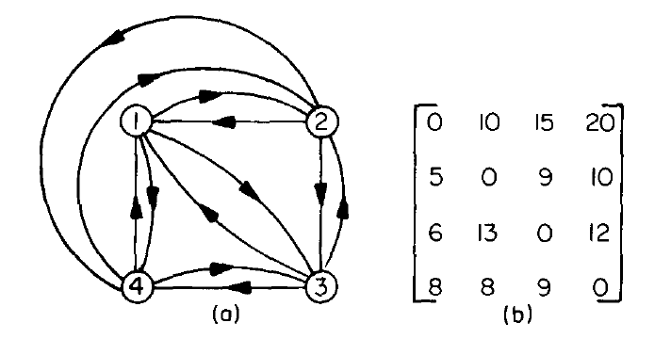
Practice Problem
Directed graph and edge length matrix c

Slide 11
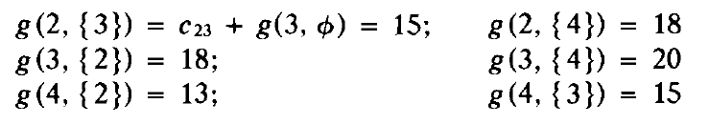
TSP : Using Dynamic Programming
Using (2)

Slide 12
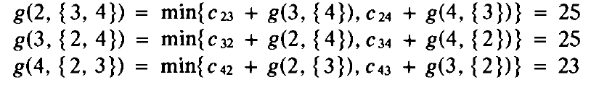
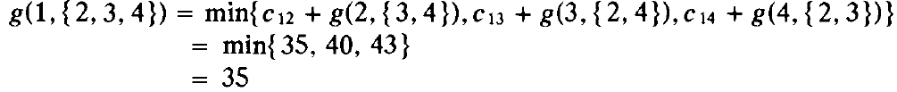
TSP : Using Dynamic Programming
Finally, from (1) we obtain

Slide 13
TSP : Using Dynamic Programming
An optimal tour of the graph has length 35.
A tour of this length may be constructed if we retain with each g(i,S) the value of j that minimizes the right hand side of (2).
Let J(i,S) be this value.
Then, J(1, {2, 3, 4}) = 2. Thus the tour starts from 1 and goes to 2.
The remaining tour may be obtained from g(2, {3, 4}). J(2, {3, 4}) = 4.
Thus the next edge is (2, 4).
The remaining tour is for g(4, {3}). J(4, {3}) = 3.
The optimal tour is 1, 2, 4, 3, 1.

Slide 14
End.

